Slide 1
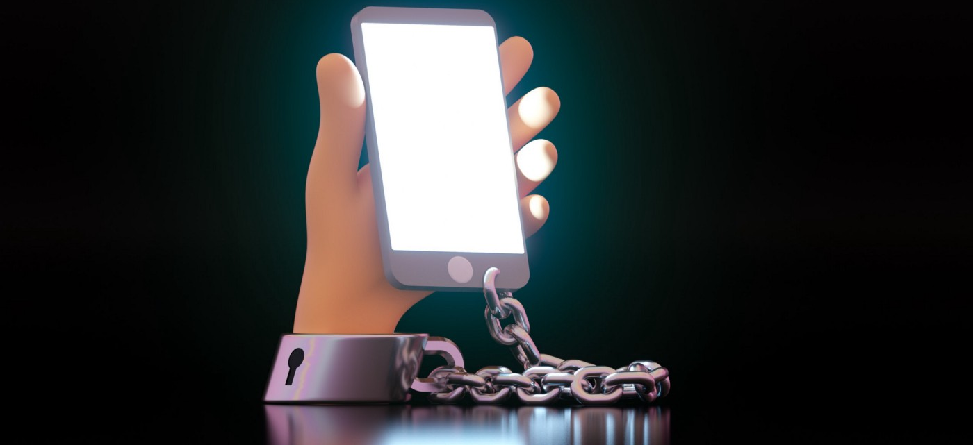

Is Social Media Degrading Humanity?

Slide 2
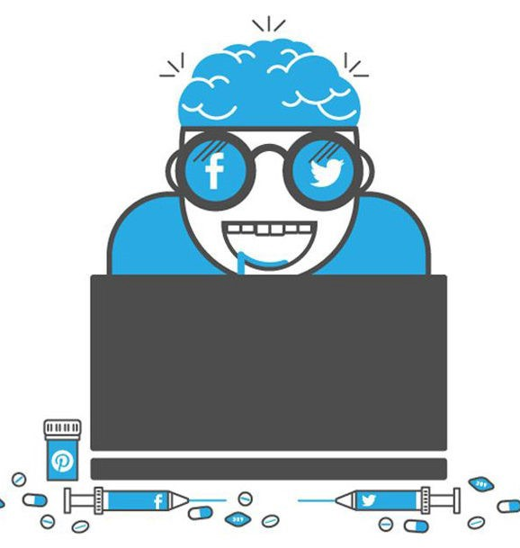
Is Social Media Degrading Humanity?
FACTUAL ARGUMENTS

Slide 3
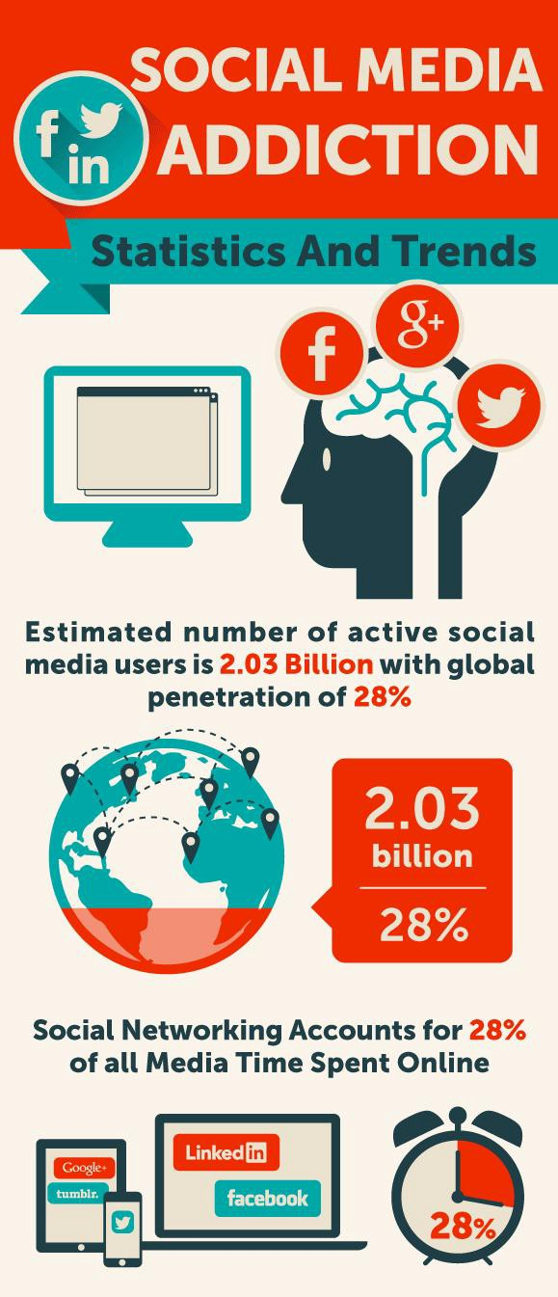
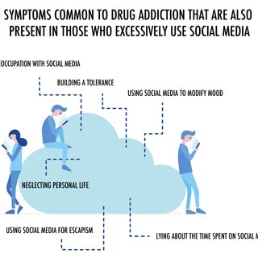
Social Media Addiction
Affecting Mental Health

Slide 4
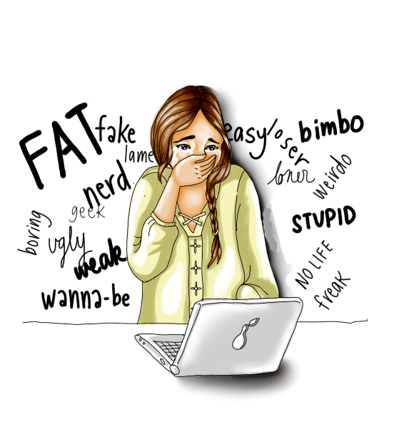
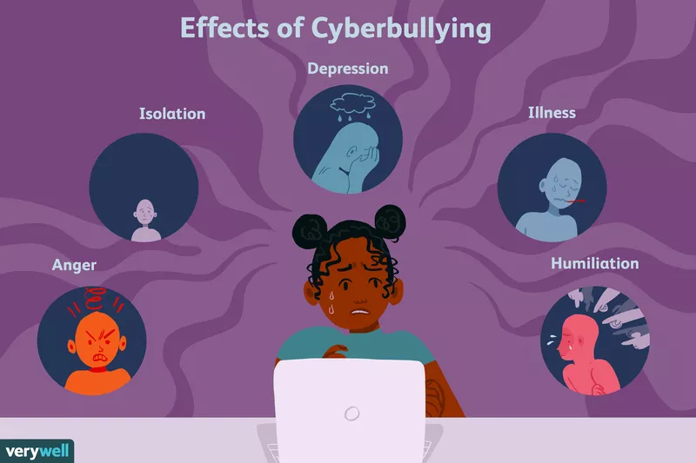
Cyberbullying
People /childrens have become victims of the cyber bullying over the past.
With fake accounts, they are publicly harassing one another, and posting means or slanderous things which are broadcasted to the entire cyber world.

Slide 5
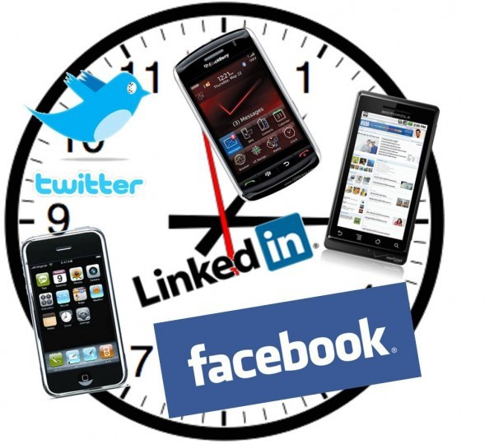

Time Consuming|Distraction
Social media fails
Decreases productivity
Loss of motivation
Distracts From lives goal

Slide 6
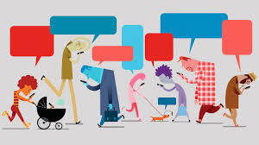
Is Social Media Degrading Humanity?
EMOTIONAL ARGUMENTS

Slide 7
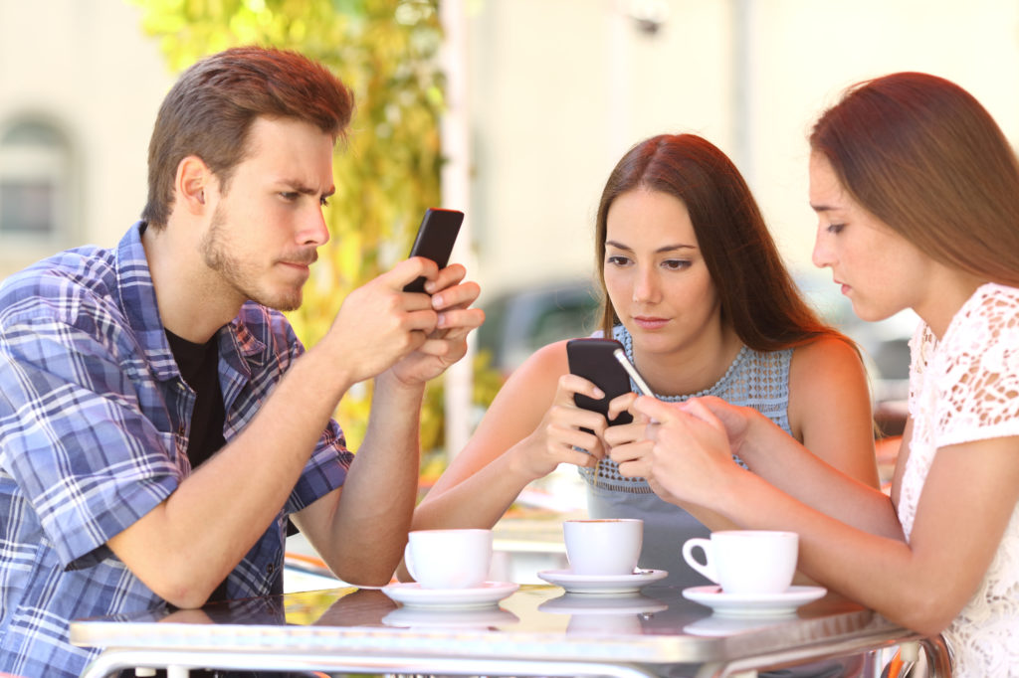
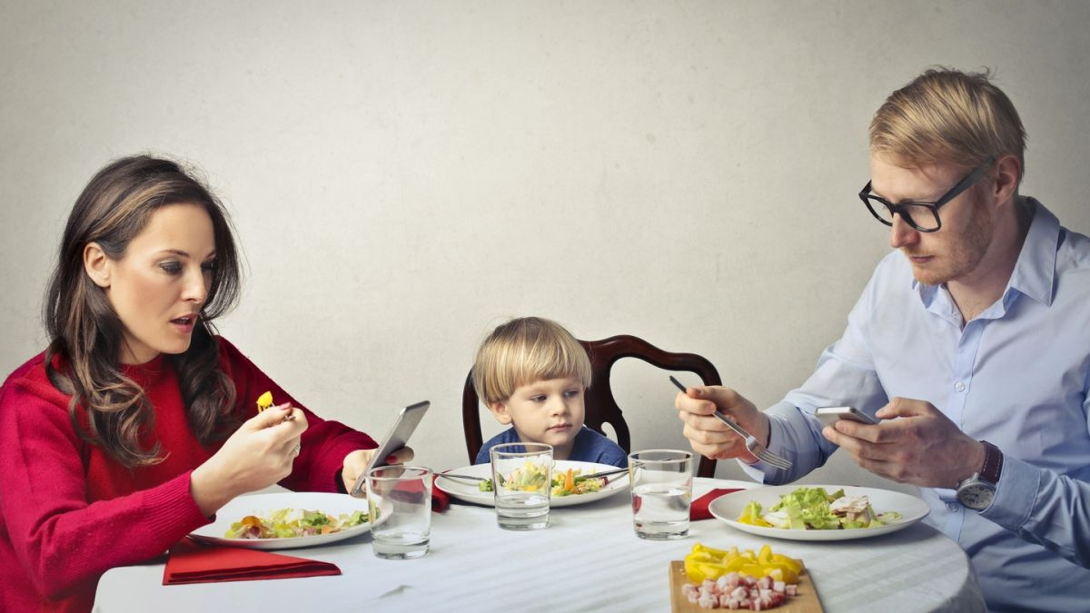
Reduces Face-to Face Interaction
When you are on social media more often:
Spend less quality time with people who are physically present in your life
They will quickly get annoyed when you’re mindlessly scrolling through social media platforms instead of paying attention to them.

Slide 8
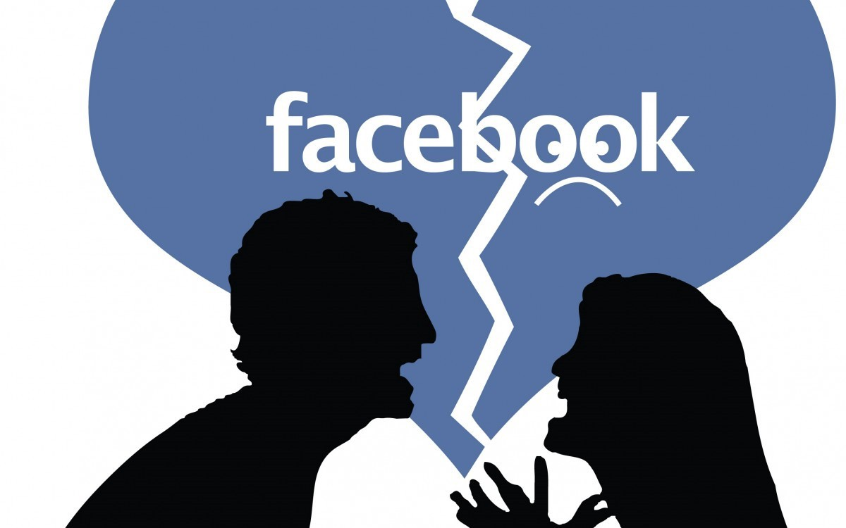
Relationship problems
Studies show that the more a person uses Facebook, the more likely they will be to monitor their partner, which leads to arguments and crumbling relationships.

Slide 9
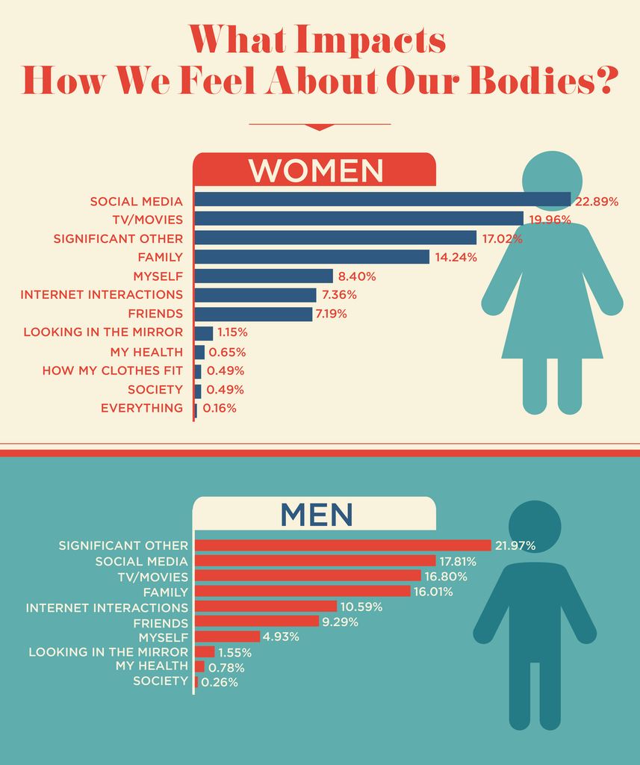
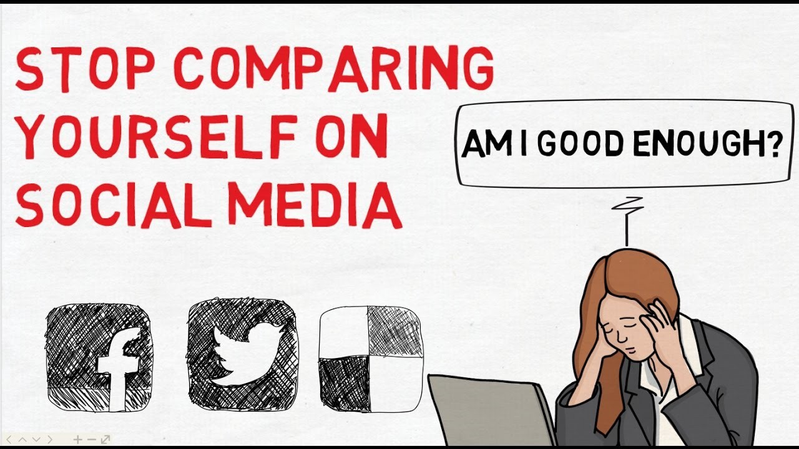
High Risk of Depression
Social Comparison Reduces Self-Esteem
Increases Cravings for Attention/Jalousy
Social anxiety

Slide 10
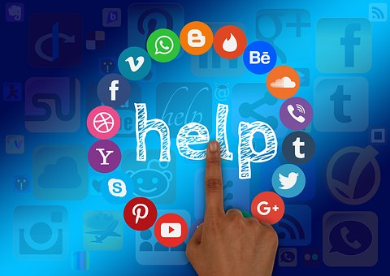
Is Social Media Degrading Humanity?
RATIONAL ARGUMENTS

Slide 11
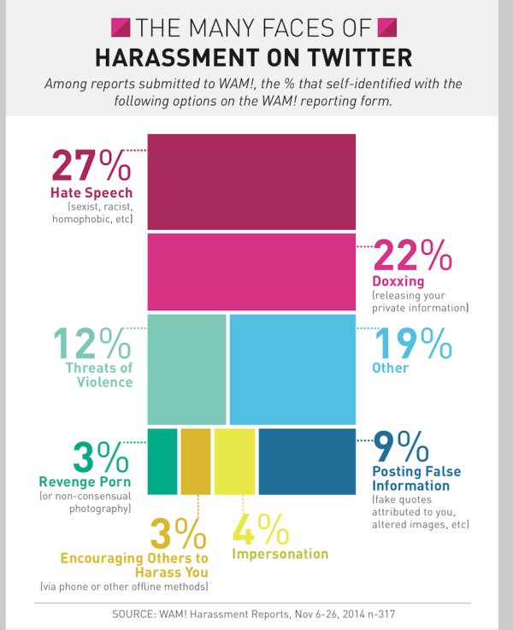
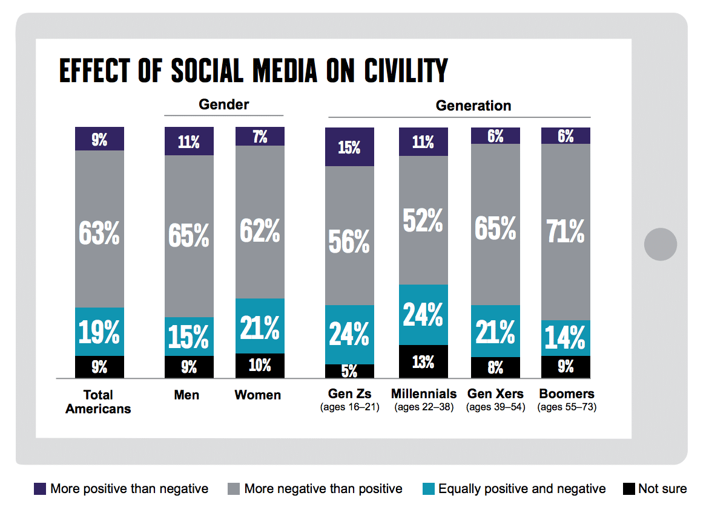
AWAWRNESS

Slide 12

Our Team
Fadoua Zouaoui

